Slide 1

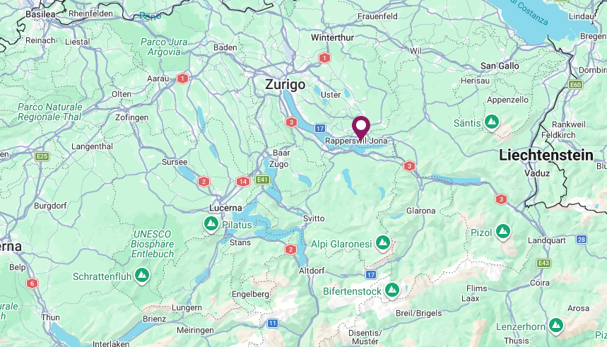
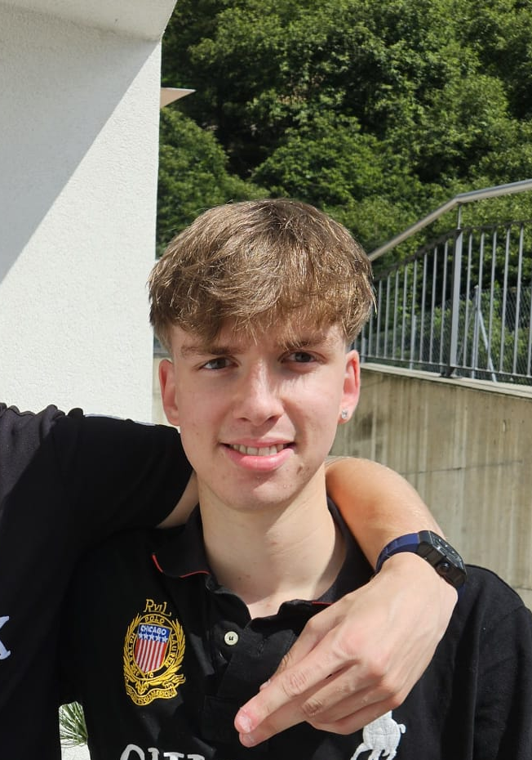
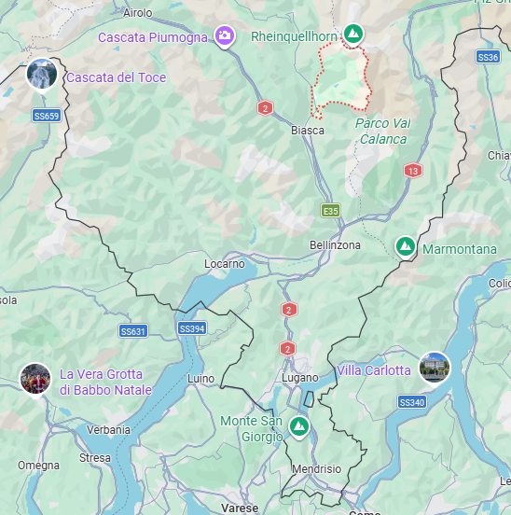



Nicola Giamboni
University: Eastern Switzerland University of Applied Sciences (OST)
Study program: Civil Engineering
Year of study: 5th Semester
City: Rapperswil, Switzerland
Motto for life: What you do today shapes who you become tomorrow.
Hobbies: play football and go hinking
Your expectations from the summer school:
Meet new people from all over the world and learn new things about sustainability.
Rapperswil, Switzerland
Location where I live ↑,
Location of my origin ↓
Ticino, Switzerland
Karlsruhe
31 August to 11 September 2026

